Slide 1
  本讲内容
关联规则
  Write-based、DFS算法
    VIPER
      Implement DFS with bitmap compression of data in vertical format
    FP-Growth算法
      Implement DFS using a tree structure in horizontal format
    FP-Growth based sub-graph mining

Slide 2
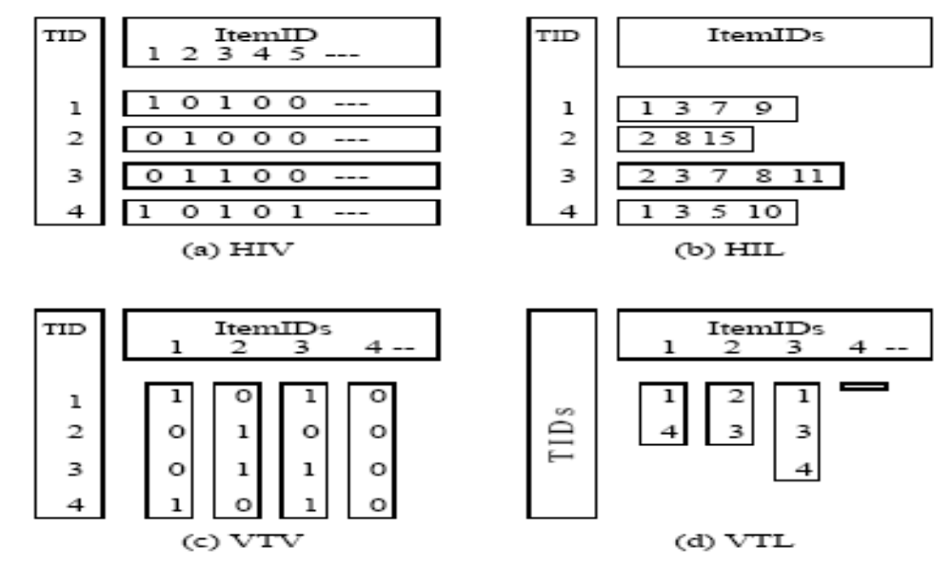
Comparison of Data Layouts

Slide 3

Vertical format for write-based FPM
Vertical format
a-TID
10
30
b-TID
20
30
40
c-TID
10
20
30
d-TID
10
TID | Items
10 | a, c, d
20 | b, c, e
30 | a, b, c, e
40 | b, e
to get TID list for {a,b} merge TID list for {a} and {b}
TID
30

Slide 4
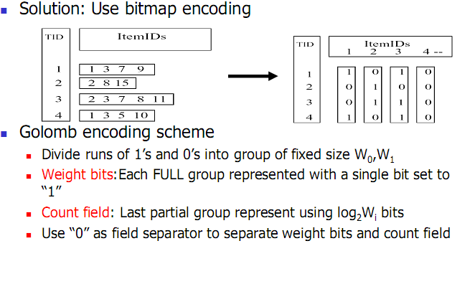
Vertical format for write-based FPM

Slide 5
  本讲内容
关联规则
  Write-based、DFS算法
    VIPER
      Implement DFS with bitmap compression of data in vertical format
    FP-Growth算法
      Implement DFS using a tree structure in horizontal format
    FP-Growth based sub-graph mining

Slide 6
FP-Growth算法
a,b,c,e
Depth-first search
Algorithm with write or point
a,b,e
a,b,e
a,c,e
b,c,e
a,b
a,c
a,e
b,c
b,e
c,e
a
b
c
e
{}

Slide 7
FP-Growth算法
a,b,c,e
Note that we can know the number of occurrence of “ab” by counting the number of “b” in the {a}-projected database !
a,b,e
a,b,e
a,c,e
b,c,e
TID | Items
30 | c, e
a,b
a,c
a,e
b,c
b,e
c,e
all rows that contain “ab”.
{ab}-projected database
a,b
TID | Items
10 | c, d
30 | b, c, e
a
a
b
c
e
all rows that contain “a”.
{a}-projected database
TID | Items
10 | a, c, d
20 | b, c, e
30 | a, b, c, e
40 | b, e
{}

Slide 8
FP-Growth算法
第一次扫描数据库：
类似于Apriori算法，找出频繁的1-itemset和他们的计 数值， 将频繁项目按频度降序排列
2. 第二次扫描数据库：
构造fp-tree （频度从大到小）
挖掘该树（频度从小到大）
注意：数据库大时，fp-tree可能在内存中装不下，需要
采取partition方法。

Slide 9
Construct FP-tree from a Transaction Database
TID Items bought (ordered) frequent items
100 {f, a, c, d, g, i, m, p} {f, c, a, m, p}
200 {a, b, c, f, l, m, o} {f, c, a, b, m}
300 {b, f, h, j, o, w} {f, b}
400 {b, c, k, s, p} {c, b, p}
500 {a, f, c, e, l, p, m, n} {f, c, a, m, p}
min_support = 3
{}
Header Table
Item frequency head
f 4
c 4
a 3
b 3
m 3
p 3
扫描数据库一遍，找到所有的频繁项目
将频繁项目按照降序排列，生成一个f-list
再扫描数据库一遍，构造FP-Tree
f:4
c:1
c:3
b:1
b:1
a:3
p:1
m:2
b:1
F-list=f-c-a-b-m-p
p:2
m:1

Slide 10
条件模式基
对所有的频繁项目，找到每一个项目在FP-Tree的所有前缀，构成每个项目的条件模式基（类似于条件或投影数据库，但去掉了部分不频繁的项目，如g，i等）
{}
Header Table
Item frequency head
f 4
c 4
a 3
b 3
m 3
p 3
f:4
c:1
Conditional pattern bases
item cond. pattern base
f
c f:3
a fc:3
b fca:1, f:1, c:1
m fca:2, fcab:1
p fcam:2, cb:1
c:3
b:1
b:1
a:3
p:1
m:2
b:1
p:2
m:1

Slide 11
递归构造条件模式基
用每一个项目的条件模式基作为输入，递归FP-Growth算法
m-conditional pattern base:
  fca:2, fcab:1
{}
Header Table
Item frequency head
f 4
c 4
a 3
b 3
m 3
p 3
f:4
c:1
{}
Conditional pattern bases
item cond. pattern base
mf
mc f:3
ma fc:3
c:3
b:1
b:1

f:3

a:3
p:1
c:3
m:2
b:1
a:3
p:2
m:1
m-conditional FP-tree

Slide 12
递归构造条件模式基
用每一个项目的条件模式基作为输入，递归FP-Growth算法
ma-conditional pattern base:
  fc:3
{}
Header Table
Item frequency head
f 4
c 4
a 3
b 3
m 3
p 3
f:4
c:1
{}
Conditional pattern bases
item cond. pattern base
maf
mac f:3
c:3
b:1
b:1


f:3
a:3
p:1
m:2
b:1
c:3
p:2
m:1
ma-conditional FP-tree

Slide 13
递归构造条件模式基
用每一个项目的条件模式基作为输入，递归FP-Growth算法
mac-conditional pattern base:
  f:3
{}
Header Table
Item frequency head
f 4
c 4
a 3
b 3
m 3
p 3
f:4
c:1
{}
Conditional pattern bases
item cond. pattern base
macf
c:3
b:1
b:1

f:3

a:3
p:1
m:2
b:1
p:2
m:1
mac-conditional FP-tree

Slide 14
递归构造条件模式基
用每一个项目的条件模式基作为输入，递归FP-Growth算法
{}
Header Table
Item frequency head
f 4
c 4
a 3
b 3
m 3
p 3
f:4
c:1
All frequent patterns relate to m
m,
fm, cm, am,
fcm, fam, cam,
fcam
c:3
b:1
b:1

a:3
p:1
m:2
b:1
p:2
m:1

Slide 15
构造FP-tree
  为了快速生成各个频繁集合的投影数据库，避免顺序扫描
挖掘FP-tree
  就是一个按照深度优先顺序生成投影数据库的过程。
  每一个需要为其生成投影数据库的集合，都是频繁集。不频繁集在构造FP-Tree时就过滤掉了
  当递归结束时，只要把所有的频繁集合并就是最后的所有频繁集

Slide 16
Benefits of the FP-tree Structure
Completeness
  Preserve complete information for frequent pattern mining
  Never break a long pattern of any transaction
Compactness
  Reduce irrelevant info—infrequent items are gone
  Items in frequency descending order: the more frequently occurring, the more likely to be shared
  Never be larger than the original database (not count node-links and the count field)
  For Connect-4 DB, compression ratio could be over 100

Slide 17
Partition Patterns and Databases
Frequent patterns can be partitioned into subsets according to f-list
  F-list=f-c-a-b-m-p
  Patterns containing p
  Patterns having m but no p
  …
  Patterns having c but no a nor b, m, p
  Pattern f
Completeness and non-redundency

Slide 18
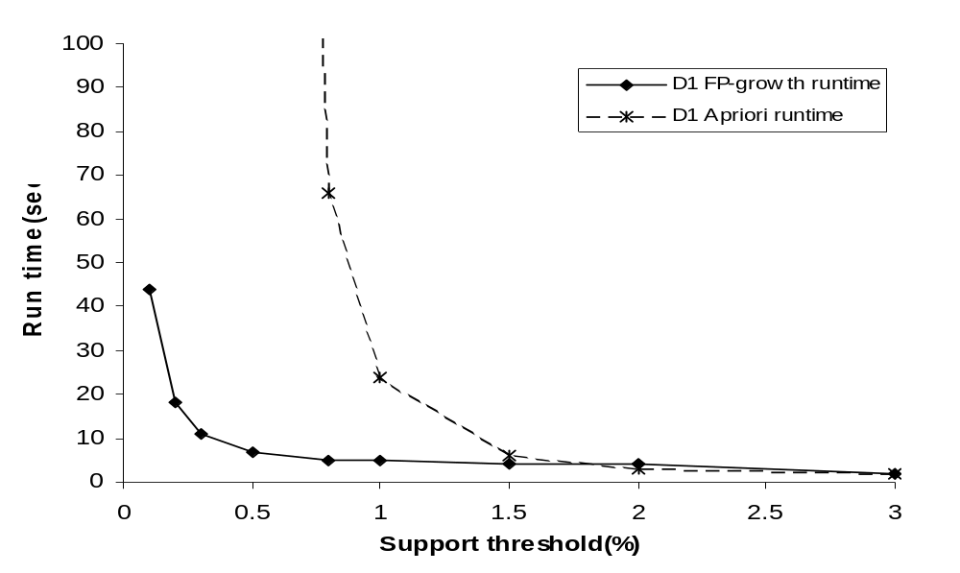
FP-Growth vs. Apriori: Scalability With the Support Threshold
Data set T25I20D10K

Slide 19
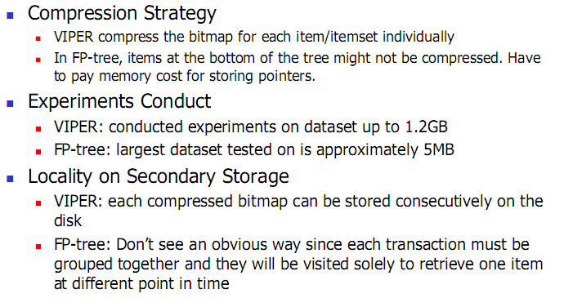
VIPER vs. FP-Growth: Comparision

Slide 20
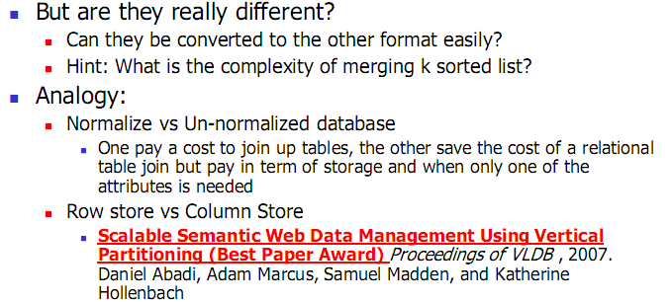
VIPER vs. FP-Growth: Comparision

Slide 21
Why would write-based algorithms be faster ?
Read-based FPM algorithms like Apriori algorithm which will “forget” its previous processing. Eg. let the frequent itemset {a,b,c,d,e} be frequent. Let ‘s look at a record containing {a,b,c}.
Level Candidate Record
1-itemset {a} {TID=10: a, b, c}
2-itemset {a,b} {TID=10: a, b, c}
3-itemset {a,b,c} {TID=10: a, b, c}
Write-based FPM avoid this repeated scanning by doing depth first search
scanned
scanned
scanned
Level Candidate Record
1-itemset {a} {TID=10: a, b, c}
2-itemset {a,b} {TID=10: b, c}
3-itemset {a,b,c} {TID=10: c}

Slide 22
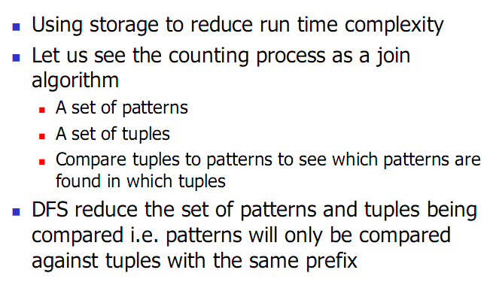
Why would write-based algorithms be faster ?

Slide 23
However......
a,b,c,e
Write-based algorithm usually pay a higher cost in term of space complexity.
Projected databases are materialize for all the red circles on the way to getting the {a,b} projected database.
a,b,e
a,b,e
a,c,e
b,c,e
TID | Items
30 | c, e
a,b
a,c
a,e
b,c
b,e
c,e
all rows that contain “ab”.
{ab}-projected database
a,b
TID | Items
10 | c, d
30 | b, c, e
a
a
b
c
e
all rows that contain “a”.
{a}-projected database
TID | Items
10 | a, c, d
20 | b, c, e
30 | a, b, c, e
40 | b, e
{}

Slide 24
TID | Items
10 | a, c, d, f
20 | b, c, e
30 | a, b, c, e
40 | b, e
e
a
b
c
TID | Items
10 | c, d
30 | b, c, e
TID | Items
20 | c, e
30 | c, e
40 | e
TID | Items
20
30
40
TID | Items
10 | d,f
20 | e
30 | e
ab
ac
ae
TID | Items
30 | c, e
TID | Items
10 | d
30 | e
TID | Items
30 | e
abc
abe

Slide 25
No candidates ?
There are claims that write-based algorithm are faster because they don’t generate candidates. This is not true in general. Example, if minsup is 30%, then all the items in the {a}-projected database are false candidates ! (i.e. {a,b}, {a,c}, {a,d}, {a,e}, {a,f} and {a,g} are never frequent
TID | Items
10 | a, c, d
20 | b, c, e
30 | a, b, c, e
40 | a, f
50 | b,c
60 | a,g
70 | f, g,
80 | e, g
90 | a,b ,g
100 | b, e
TID | Items
10 | c, d
30 | b, c, e
40 | f
60 | g
90 | b, g
{a}-projection

Slide 26
So far, we covered
 | Read-based | Write-based | Point-based
Association Mining | Apriori[AgSr94] | VIPER[SHSB00] FPGrowth [HaPe00]
Sub-Graph Mining | AGM[PKDD’00] FSG[ICDM’01] | Mofa[ICDM’02] gSpan[ICDM’02]
Sequential Pattern Discovery | GSP[AgSr96] | PrefixSpan [PHPC01]
Iceberg Cube | Apriori[AgSr94] |  | BUC[BeRa99], H-cubing [HPDW01]

Slide 27
  本讲内容
关联规则
  Write-based、DFS算法
    VIPER
      Implement DFS with bitmap compression of data in vertical format
    FP-Growth算法
      Implement DFS using a tree structure in horizontal format
    FP-Growth based sub-graph mining

Slide 28
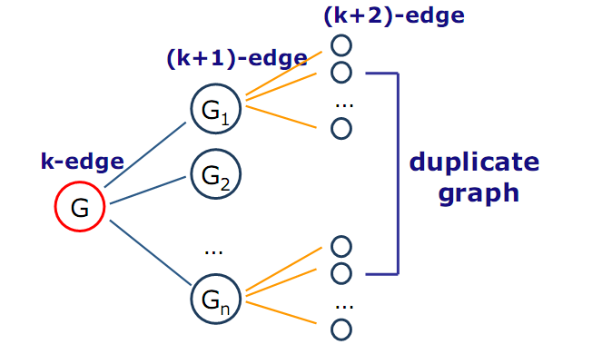
Sub-Graph Mining---pattern growth method

Slide 29
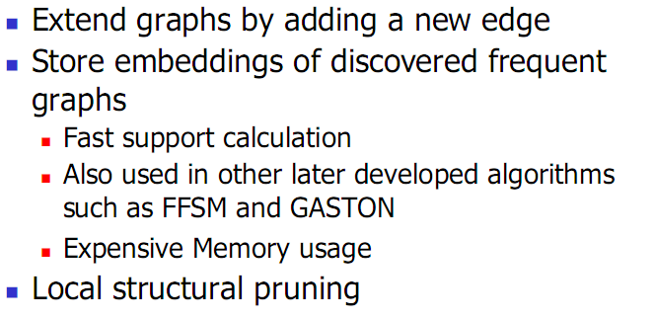
Mofa (ICDM’02)

Slide 30
gSpan (Yan & Han, ICDM’02)
K edges
(K-1) edges
Enumerate G0
in the graph dataset;
At the same time,
Count the frequency
of G1, G2, … Gn.
G1
G0
G2
…
Gn
Output Frequent Ones
in G1, G2, …, Gn.
Notes:
Apriori:
Step1: Join two k-1 edge graphs (these two graphs share a same k-2 edge subgraph) to generate a k-edge graph
Step2: Join the tid-list of these two k-1 edge graphs, then see whether its count is larger than the minimum support
Step3: Check all k-1 subgraph of this k-edge graph to see whether all of them are frequent
Step4: After G successfully pass Step1-3, do support computation of G in the graph dataset, See whether it is really frequent.
gSpan:
Step1: Right-most extend a k-1 edge graph to several k edge graphs.
Step2: Enumerate the occurrence of this k-1 edge graph in the graph dataset, meanwhile, counting these k edge graphs.
Step3: Output those k edge graphs whose support is larger than the minimum support.
Pros:
1: gSpan avoid the costly candidate generation and testing some infrequent subgraphs.
2: No complicated graph operations, like joining two graphs and calculating its k-1 subgraphs.
3. gSpan is very simple
The key is how to do right most extension efficiently in graph. We invented DFS code for graph.

Slide 31
gSpan (cont.)
gSpan extends a k-edge graph to a (k+1)-edge graph by adding one edge
gSpan chooses only one depth-first search tree in a graph which produces the minimum DFS code, the canonical label of the graph
gSpan only adds new edges on the vertices along the right-most path of the depth-first search tree

Slide 32
Right-Most Extension
0
0
1
1
2
2
3
5
3
5
4
4
(a)
(b)
Backward-edge extension
Notes:
1: Given a graph in (a), suppose, the DFS traverse the graph in the order 0, 1, 2, 3, 4
2: The vertices 0, 1, 2 and 4 constitute the right-most path, and vertex 4 is called the right-most vertex (the last discovered vertex)
3: Any extension must take place on the right-most path: first, the backward edge can only extend from the right most vertex;
Second, the forward edge can extend from any vertices on the right-most path.
4: The extension of a graph is equal to the extension of its DFS code by appending a new edge in the end.

Slide 33
Right-Most Extension (cont.)
0
0
1
1
2
2
3
5
3
5
4
4
(a)
(b)
Forward-edge extension
Notes:
1: Given a graph in (a), suppose, the DFS traverse the graph in the order 0, 1, 2, 3, 4
2: The vertices 0, 1, 2 and 4 constitute the right-most path, and vertex 4 is called the right-most vertex (the last discovered vertex)
3: Any extension must take place on the right-most path: first, the backward edge can only extend from the right most vertex;
Second, the forward edge can extend from any vertices on the right-most path.
4: The extension of a graph is equal to the extension of its DFS code by appending a new edge in the end.

Slide 34
Avoid Duplicate Extension
(1)
(2)
(2)
(1)
They are the same graph, but they grow in different ways.
The cost to detect them is huge if there are lots of such
duplicate growths.

Slide 35
Right-most Extension
(1)
(2)
(2)
(1)
(1)
Theorem:
  Any graph can be grown by right-most extension
We will never generate this

Slide 36
Search Space in gSpan
1-edge
...
2-edge
...
G
...
...
G1
...
Gn
3-edge
...
...
...

Slide 37
DFS Code
Flatten a graph into a sequence such that any
right-most extension takes place in the end of
the sequence.
e0: (0,1,X,a,X)
X
a
b
e1: (1,2,X,a,Y)
X
c
a
e2: (2,0,Y,b,X)
Y
d
b
e3: (2,3,Y,b,Z)
Z
Z
e4: (3,0,Z,c,X)
e5: (2,4,Y,d,Z)
Notes:
1: Show how to construct a DFS code, which is related with right most extension
2: One graph has lots of DFS code, among them, there is a minimum DFS code. We invent a DFS lexicographic ordering system.
Among this ordering, we take minimum DFS code as canonical label.

Slide 38
DFS Code (cont.)
We call a graph with a DFS tree subscripted by subscripted graph
DFS Code ←→ subscripted graph
Actually, the construction of DFS Code is a right-most extension procedure to extend a graph
We call a subscripting which can generate the minimum DFS code by a base subscripting
We only conduct right-most extension on this base subscriptig
Base subscripting + one edge right-most extension MAY NOT be another base subscripting

Slide 39
Reduce the Number of G1, … Gn
0
1
2
3
5
4
#= 6 + 10 =16

Slide 40
Right-Most Extension (cont.)
Number of Extensions = 16
right-most extension
Number of Extensions = 6

Slide 41
So far, we covered
 | Read-based | Write-based | Point-based
Association Mining | Apriori[AgSr94] | VIPER[SHSB00] FPGrowth [HaPe00]
Sub-Graph Mining | AGM[PKDD’00] FSG[ICDM’01] | Mofa[ICDM’02] gSpan[ICDM’02]
Sequential Pattern Discovery | GSP[AgSr96] | PrefixSpan [PHPC01]
Iceberg Cube | Apriori[AgSr94] |  | BUC[BeRa99], H-cubing [HPDW01]

Slide 42
PrefixSpan: Example of Write-based Method
SDB
SID | sequence
10 | <a(abc)(ac)d(cf)>
20 | <(ad)c(bc)(ae)>
30 | <(ef)(ab)(df)cb>
40 | <eg(af)cbc>
Length-1 sequential patterns
<a>, <b>, <c>, <d>, <e>, <f>
Having prefix <a>
Having prefix <c>, …, <f>
Having prefix <b>
<a>-projected database
<(abc)(ac)d(cf)>
<(_d)c(bc)(ae)>
<(_b)(df)cb>
<(_f)cbc>
<b>-projected database
…
Length-2 sequential
patterns
<aa>, <ab>, <(ab)>,
<ac>, <ad>, <af>
… …
Having prefix <aa>
Having prefix <af>
<aa>-proj. db
…
<af>-proj. db

Slide 43
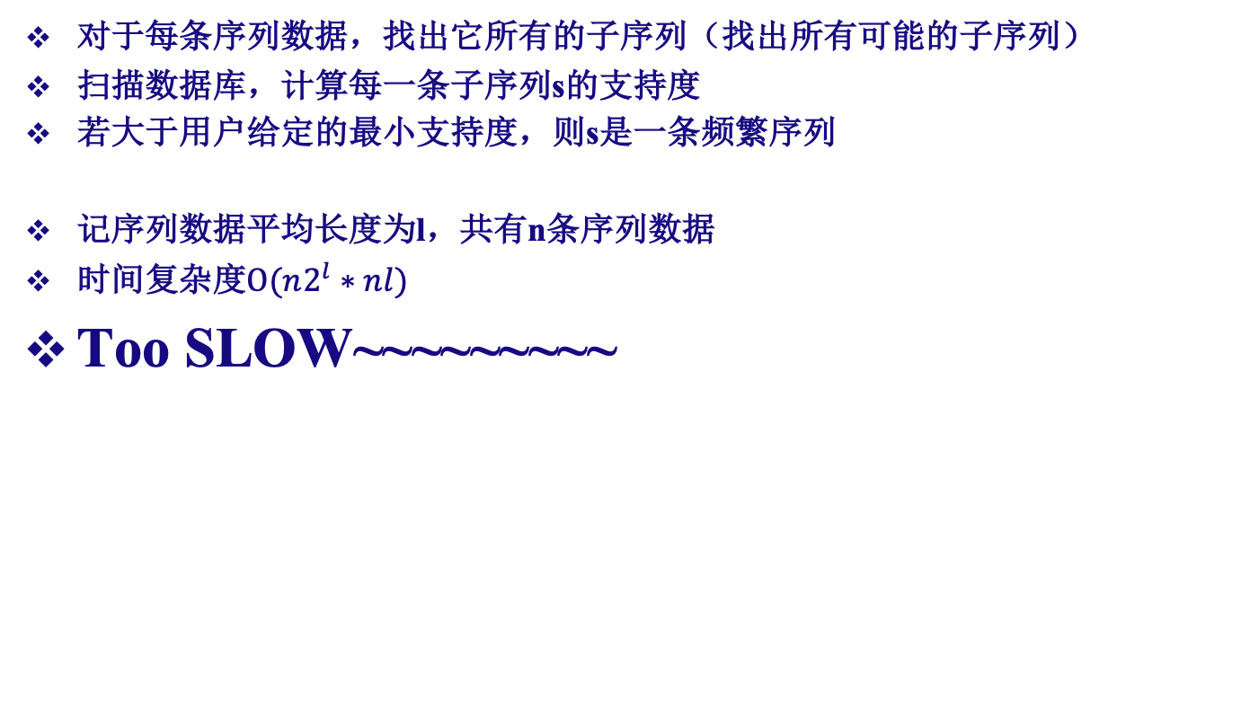
寻找频繁序列 – 朴素算法
对于每条序列数据，找出它所有的子序列（找出所有可能的子序列）
扫描数据库，计算每一条子序列s的支持度
若大于用户给定的最小支持度，则s是一条频繁序列
记序列数据平均长度为l，共有n条序列数据
时间复杂度$O(n2^{l}∗nl)$
Too SLOW~~~~~~~~~

Slide 44
寻找频繁序列 – 优化
慢在哪里？
枚举太多非频繁的子序列
  <cba>
  <eg>
  <gf>
  ……
  甚至<g>本身就不是频繁序列
SID | sequence
10 | <a(abc)(ac)d(cf)>
20 | <(ad)c(bc)(ae)>
30 | <(ef)(ab)(df)cb>
40 | <eg(af)cbc>

Slide 45
寻找频繁序列 – 优化
观察<g>和<gf>
他们都不是频繁序列
<g>是<gf>的前缀
前缀都不是频繁序列
整体可能是频繁序列吗？
利用前缀，在枚举过程中，去除不必要的子序列（剪枝）
SID | sequence
10 | <a(abc)(ac)d(cf)>
20 | <(ad)c(bc)(ae)>
30 | <(ef)(ab)(df)cb>
40 | <eg(af)cbc>

Slide 46
PrefixSpan算法
Prefix-Projected Pattern Growth，前缀投影的模式挖掘。
S的投影：在某序列数据中，以S为前缀的最长子序列的后缀
以序列数据<a(abc)(ac)d(cf)>为例
前缀S | S的投影
<a> | <(abc)(ac)d(cf)>
<aa> | <(_bc)(ac)d(cf)>
<ab> | <(_c)(ac)d(cf)>
<cd> | <(cf)>
Notes:
“_”的含义：前缀占用了序列数据中一个项集的字母，后缀仍可匹配该项集中的后续字母

Slide 47
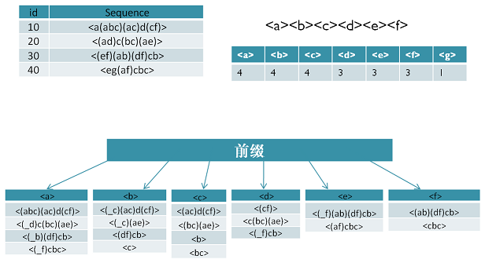
PrefixSpan算法 – 流程
先找长度为1的子序列
筛出其中的频繁序列，称他们为S1
计算每个S1在每条序列数据中的投影
对于每个S1，在其投影中找一个字母连上它
得到长度为2的子序列
筛出其中的频繁序列，称他们为S2
计算每个S2在每条序列数据中的投影
对于每个S2，在其投影中找一个字母连上它
……
直到某次已经没有频繁序列，算法结束

Slide 48
PrefixSpan算法 – 流程
以<d>为例运行算法
① <d>
② <d>： <dc> <df> <db> <da> <de> <(df)>
③ <dc>： <d(cf)> <dcb> <dca> <dce>
③ <db>： <d(bc)> <dba> <dbe>
④<dcb>： <dc(bc)> <dcba> <dcbe>
找不出更长的频繁序列，算法的<d>分支结束。
<d>
<(cf)>
<c(bc)(ae)>
<(_f)cb>
<dc>
<(_f)>
<(bc)(ae)>
<b>
<db>
<(_c)(ae)>
<dcb>
<(_c)(ae)>

Slide 49
PrefixSpan算法 – 流程
用类似的方法可以找出其他以<a> <b> <c> <e> <f>为前缀的频繁序列

Slide 50
PrefixSpan算法 – 小结
基于一个直观思想：
若S都不是频繁序列，则以S为前缀的子序列更不可能是频繁序列
与朴素算法比较：
与其他算法（GSP、FreeSpan）比较：
优势较大，主要在于投影数据集合收缩较快
 | PrefixSpan | 朴素
枚举子序列 | 长度增加，子序列数量急剧增长 更难成为频繁序列，大量子序列被筛去 开销保持稳定较小 | 长度增加，子序列数量急剧增长 没有筛去无用子序列（剪枝） 开销极大
检验频繁序列 | 只在每条序列数据的投影里匹配，开销不断缩小 | 在每条完整的序列数据里匹配，开销大
总结 | 时空开销小，算法结束快 | 时空开销大，运行时间长

Slide 51
PrefixSpan算法 – 小结
PrefixSpan算法的时间复杂度并没有减小
只是因为筛去无用子序列从而在实际应用中表现较好
极端情形：
每条序列数据都只有微小差别
现实中很难出现
高度相似的采样可以被合并处理

Slide 52
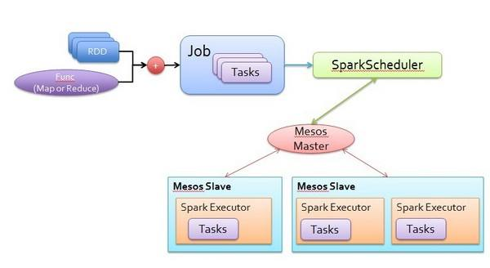
PrefixSpan算法 – 拓展
PrefixSpan具有很好的可并行性
例如：以<a>和<d>为前缀的子序列是不同（独立）的
因此，可以并行搜索以其为前缀的频繁序列
在分布式大数据平台中能够很好地提升性能
例如：Spart的Mllib

Slide 53
So far, we covered
 | Read-based | Write-based | Point-based
Association Mining | Apriori[AgSr94] | VIPER[SHSB00] FPGrowth [HaPe00]
Sub-Graph Mining | AGM[PKDD’00] FSG[ICDM’01] | Mofa[ICDM’02] gSpan[ICDM’02]
Sequential Pattern Discovery | GSP[AgSr96] | PrefixSpan [PHPC01]
Iceberg Cube | Apriori[AgSr94] |  | BUC[BeRa99], H-cubing [HPDW01]

Slide 54
关联规则应用案例1
《PR-Miner: Automatically Extracting Implicit Programming Rules and Detecting Violations in Large Software Code 》应用正关联规则在大型软件代码中进行漏洞检测
《NAR-Miner: Discovering Negative Association Rules from Codefor Bug Detection》应用负关联规则在大型软件代码中进行漏洞检测

Slide 55
关联规则应用案例1
程序遵循编程规则，如对于lock与unlock函数对，调用lock后需要调用unlock
除了明显的编程规则外，在规模庞大的软件代码中还存在许多更复杂的隐式编程规则，规则涉及的程序元素（函数，变量，数据类型等）也更多
在源代码中，这些程序元素经常一起出现。当程序元素（函数）A出现时，元素B也应该出现。因此，如果一个函数违反了规则(即，包含一个A而不包含一个B)，那么就有可能出现潜在的bug
这种关系表现为一种正相关的模式

Slide 56
关联规则应用案例1
而在实际的编程中，同时存在负相关规则：当A出现时，B不应该出现，反之亦然
一个负相关的规则反映了A和B之间相互压制或相互冲突的关系，A、B很少同时出现，违反负规则也可能导致bug
因此，就需要通过相应的方式自动地从大型系统源代码中提取正、负关联规则，并检测它们的违规从而发现bug

Slide 57
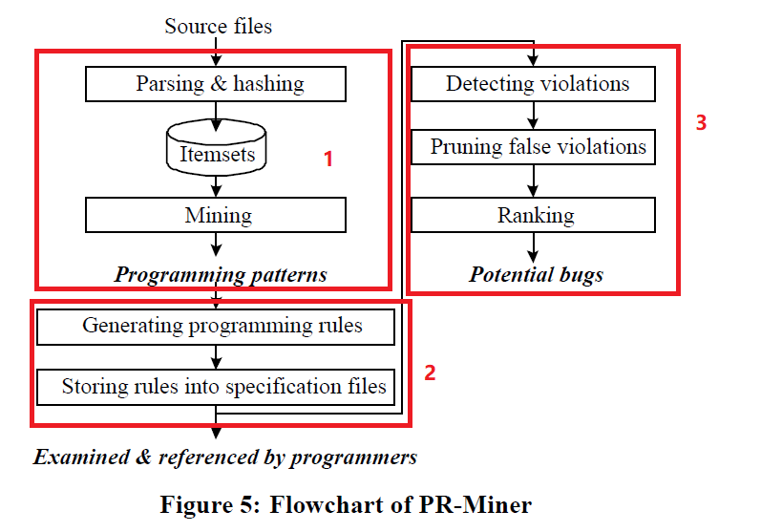
关联规则应用案例1
使用正关联规则进行代码检测的流程图如下:

Slide 58
关联规则应用案例1
例如，用频繁模式挖掘算法可以找到{spin lock irqsave, spin unlock irqrestore} 是一种频繁编程模式，它在Linux源代码中出现了3600多次
将生成频繁编程模式的问题转换为频繁项集挖掘问题，步骤如下：

Slide 59
关联规则应用案例1
1、使用GCC编译程序，获取程序中间表示形式
2、以函数(将函数而不是基本块转换为itemset的原因是，大多数编程规则通常发生在函数的范围内)为单位，对程序元素（包括标识符名称、数据类型名称、关键字、操作符、控制结构等。）进行hash操作，将每一个函数映射成为一个包含程序元素hash值的项集
3、对得到的项集数据库进行频繁项集挖掘

Slide 60
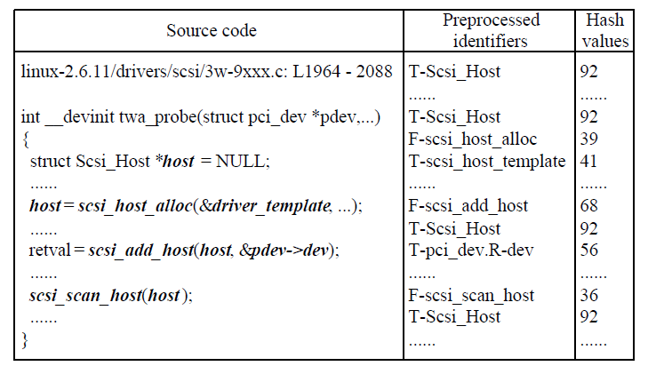
关联规则应用案例1

Slide 61
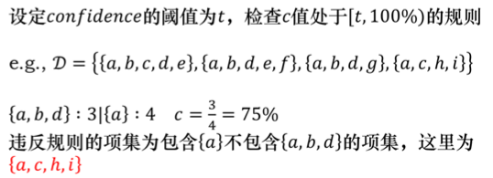
关联规则应用案例1
仅提取频繁编程模式是不够的，模式可能会导致许多不同的规则。因此，还需要根据条件概率（置信度）由频繁模式生成关联规则。

Slide 62
应用案例2
工业界里面经常需要做一些实时大规模的数据分析，比如传感器网络的Anomaly Detection及对应的root cause，或者找有特定行为模式的用户群体的共性做特征抽取，或是在大规模data stream中发现新的trend，等等
Stanford DAWN project：https://dawn.cs.stanford.edu/projects/
MacroBase 系统：is a new analytic monitoring engine designed to prioritize human attention in large-scale datasets and data streams. Unlike a traditional analytics engine, MacroBase is specialized for one task: finding and explaining unusual or interesting trends in data.

Slide 63
应用案例2
Demonstration: MacroBase, A Fast Data Analysis Engine
{Peter Bailis, Edward Gan, and Kexin Rong, Sahaana Suri}
SIGMOD 2017 (Demo)
MacroBase: Prioritizing Attention in Fast Data
{Peter Bailis, Edward Gan, Samuel Madden, Deepak Narayanan, Kexin Rong, Sahaana Suri}
SIGMOD 2017 Awarded “Best of SIGMOD 2017”. [code]

Slide 64
应用案例2
MacroBase 是一个流数据系统，它的输入是一个Point的时间序列。每个Point有：
  Array<Metric>: Metric是用于检测这个Point是否异常的，例子包括Latency， Error Rate，环境温度等等
  Array<Attribute>: 用于描述产生这个Point的对象本身的属性，用于归因。例子包括：机器型号，服务器操作系统版本，传感器版本，数据中心所属的Region，手机App的版本，等等

Slide 65
应用案例2
MacroBase系统的输出是一个排序好的Explanation，每个Explanation会解释某个/某些Metric的异常最有可能是由于哪些Attribute引起的。排序是根据这个Explanation的可能性大小进行的。终端用户看到的是，机器认为最可信的几个可能的解释，然后人再进行进一步investigation，就能够非常快速地找到真正的原因了

Slide 66
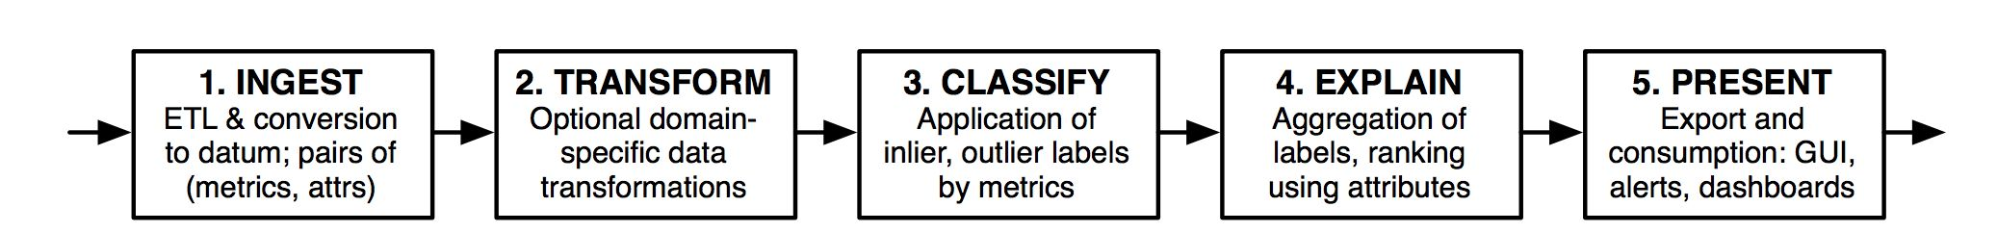
应用案例2
系统运行流程：
Ingest: 数据生成，产生最原始的Point Time Series
Transformation: 数据预处理，如聚集（将按秒采样转换为按小时采样）

Slide 67
应用案例2
系统运行流程：
Classify: 异常检测，确定哪些点异常。两种方法，做到了很好的易用性和扩展性的平衡：
  Online unsupervised learning: MacroBase自己提供的算法，根据数据distribution来自动推断哪些metric属于outlier
  User-specified Classification: 用户自己写代码判断，在一些特定领域适用

Slide 68
应用案例2
系统运行流程：
Explain: 这步的输入就是一堆(Array<Attribute>, Label)的Pair，然后找出哪些Attribute最有可能跟 异常标签相关
Present：Output到UI

Slide 69
应用案例2
Explanation，目标是找出一定的attribute combination，尽量使得Risk Ratio最大化：

Slide 70
应用案例2
对于每种组合搜索一边肯定是不现实的，时间复杂度太高。论文提出了如下优化的方法：
  Exploit cardinality imbalance：先在Outlier（比inlier少很多）里面找一些比较promising的组合（看它的support和频率有没有达到一定的阈值），然后再去inlier里面查一遍以计算risk ratio
  Individual item ratios are cheap：在对attribute进行组合之前，先对每个单个的attribute算risk ratio，然后再用risk ratio比较高的那些单个attribute进行组合，这样得到的组合更有可能也是risk ratio高的
Frequent Pattern Mining，论文使用了FP – Growth方法

Slide 71
References
[AgSr94] R. Agrawal, R. Srikant, “Fast Algorithms for Mining Association Rules”, Proc. of the 20th Int'l Conference on Very Large Databases, Santiago, Chile, Sept. 1994.
[AgSr96] R. Srikant, R. Agrawal: "Mining Sequential Patterns: Generalizations and Performance Improvements", to appear in Proc. of the Fifth Int'l Conference on Extending Database Technulogy (EDBT), Avignon, France, March 1996.
[BeRa99] Kevin S. Beyer and Raghu Ramakrishnan. “Bottom-Up Computation of Sparse and Iceberg CUBEs”. In Proceedings of the ACM SIGMOD International Conference on Management of Data, pages 359-370, June 1999.
[HPDW01] J. Han, J. Pei, G. Dong, and K. Wang, “Efficient Computation of Iceberg Cubes with Complex Measures”, Proc. 2001 ACM-SIGMOD Int. Conf. on Management of Data (SIGMOD'01), Santa Barbara, CA, May 2001.
[HPY00] J. Han, J. Pei, and Y. Yin, `` Mining Frequent Patterns without Candidate Generation'',, Proc. 2000 ACM-SIGMOD Int. Conf. on Management of Data (SIGMOD'00), Dallas, TX, May 2000.
[HaPe00] J. Han and J. Pei ``Mining Frequent Patterns by Pattern-Growth: Methodology and Implications '', ACM SIGKDD Explorations (Special Issue on Scaleble Data Mining Algorithms), 2(2), December 2000.
[PHPC01] J. Pei, J. Han, H. Pinto, Q. Chen, U. Dayal, and M.-C. Hsu, “ PrefixSpan: Mining Sequential Patterns Efficiently by Prefix-Projected Pattern Growth'', Proc. 2001 Int. Conf. on Data Engineering (ICDE'01), Heidelberg, Germany, April 2001.

Slide 72
References
[SHSB00] P.Shenoy, J. Haritsa, S. Sudarshan, G. Bhalotia, M. Bawa, D. “Turbo-Charging Vertical Mining of Large Database.” Proc. 2000 ACM-SIGMOD Int. Conf. on Management of Data (SIGMOD'00), Dallas, TX, May 2000.
[Zaki98] Mohammed J. Zaki, “Efficient Enumeration of Frequent Sequences”, 7th International Conference on Information and Knowledge Management, pp 68-75, Washington DC, November 1998.
[Zaki00] Mohammed J. Zaki, “Scalable Algorithms for Association Mining”, in IEEE Transactions on Knowledge and Data Engineering, Vol. 12, No. 3, pp 372-390, May/June 2000.
[Zaki01] Mohammed J. Zaki, “SPADE: An Efficient Algorithm for Mining Frequent Sequences”, in Machine Learning Journal, special issue on Unsupervised Learning (Doug Fisher, ed.), pp 31-60, Vol. 42 Nos. 1/2, Jan/Feb 2001.

